Slide 1

Web Services implemented in France for Low Level Flights.
Florence Barbini, Météo-France, Paris

Slide 2

Internet use and graphical products
Internet use will be accepted as mean of communication for aeronautical applications with the 75th Amendment.
For LLF, Internet is available through :
  Smart-phone
  E-book
  Personal computer
  ↓ graphical aeronautical products (SIGWX, wind charts) are available for LLF

Slide 3
Aeroweb: a met website for aeronautical users
A customizable Met website for flight preparation
  For light aviation : one-click flight documentation
  For commercial aviation : fully customizable flight documentation
2. Certification and traceability requirements

Slide 4
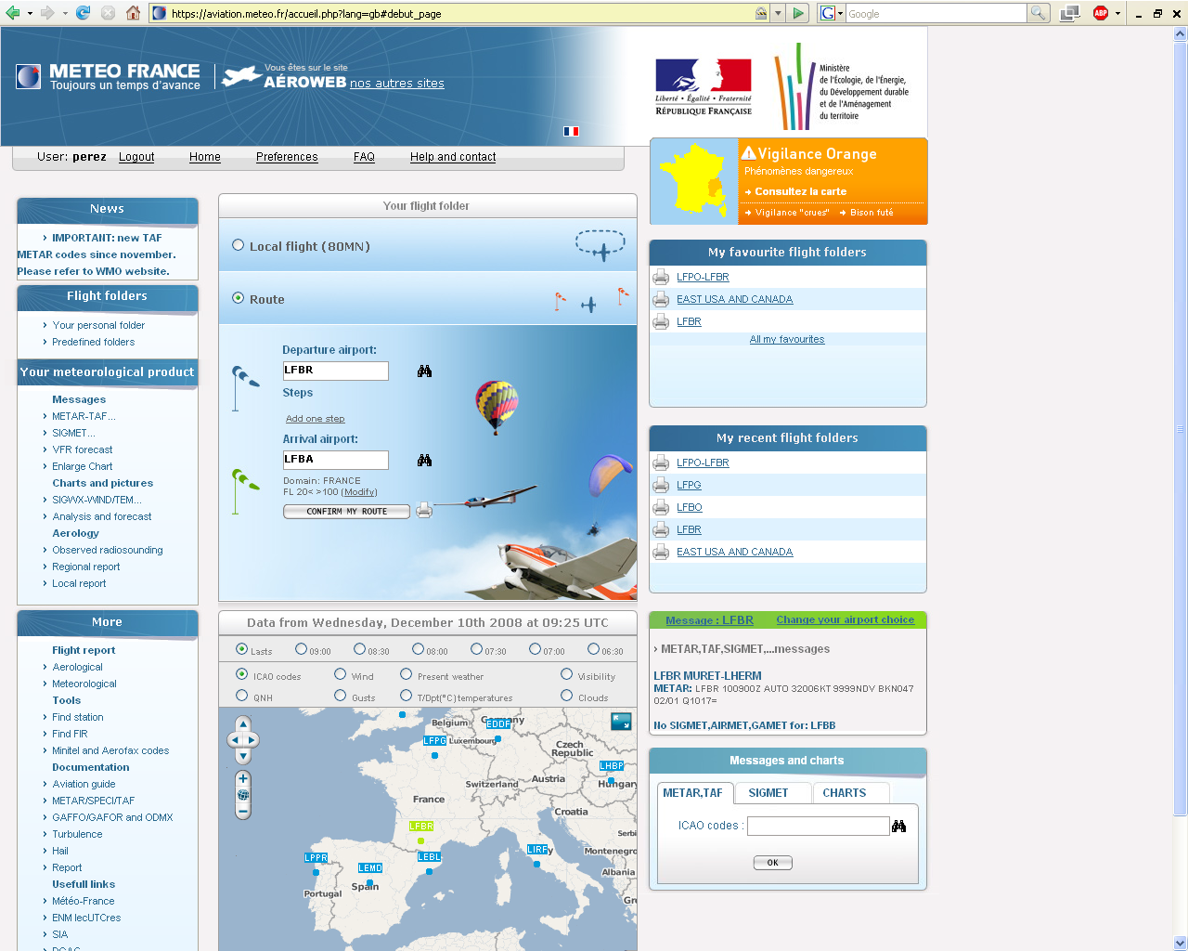
A customizable met website for flight preparation: https://aviation.meteo.fr

Slide 5
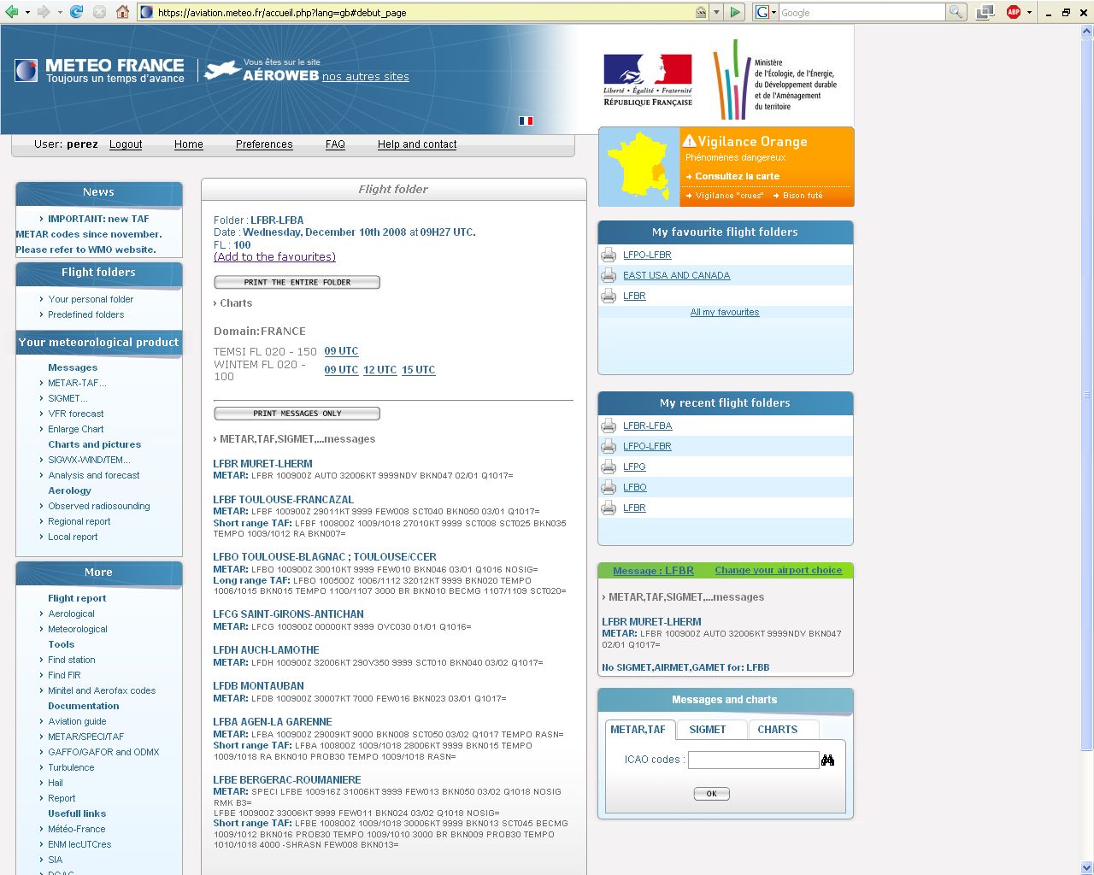
For light aviation: one-click flight documentation
Notes:
The flight documentation can be viewed on screen.
It contains:
- all meteorological data produced by airports located within 40 miles around the route (METAR, TAF, SIGMET…),
- the Significant Weather charts and the Wind-Temperature charts according to user preferences.

Slide 6
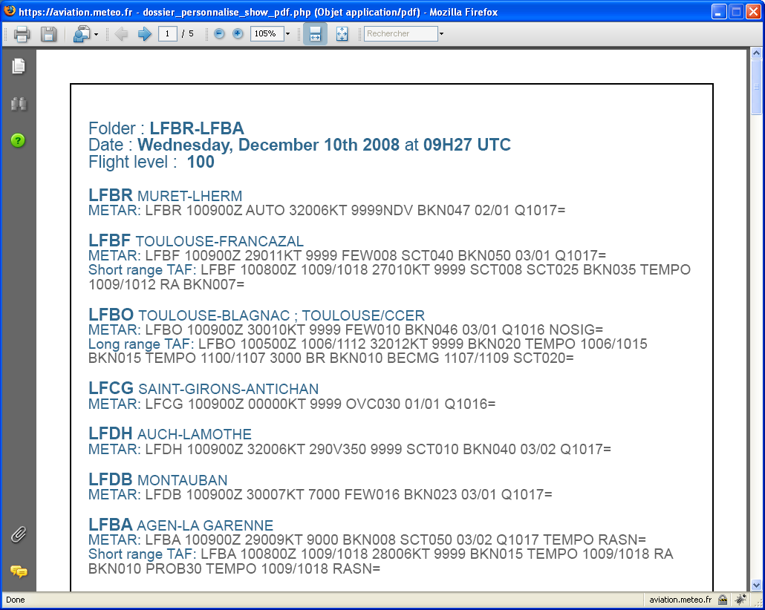
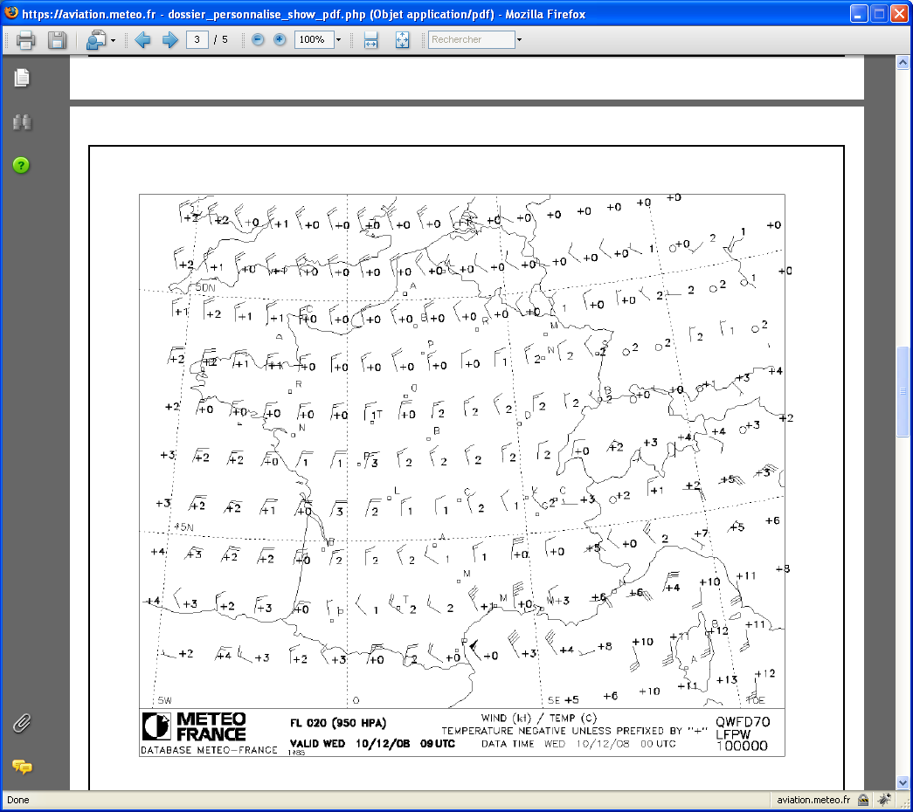
PDF-style for printing
Notes:
The flight documentation can be converted to pdf for printing

Slide 7
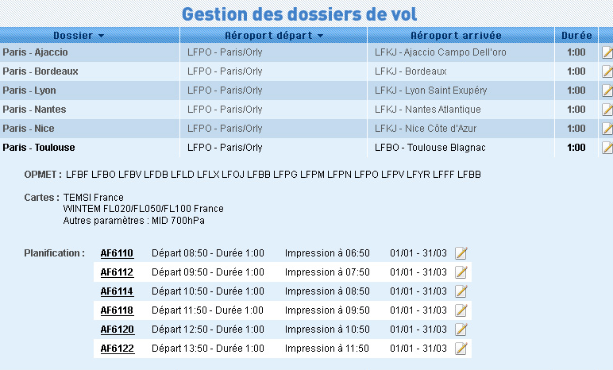
For commercial aviation: fully customizable flight documentation
The airline companies can choose, for each flight:
  Met flight documentation contents
    List of ICAO codes for METAR, TAF, SIGMET and similar messages
    Domains and validity times for WINTEM and SIGWX charts
  The scheduled time for automatic production and printing

Slide 8
Service oriented architecture (SOA)
A web service for third-party information systems (request data base)
- For whom ?
Airline companies, aeronautical providers, flight schools, Civil Aviation Authority
  - What for ?
  Getting in real time :
    Met Airport Reports and Forecast (METAR, SPECI, TAF, SIGMET…)
    Significant weather charts, Wind and Temperature charts (SIGWX, WINTEM)
  In order to put this information in flight documentation, to display on the web…
  - How ?
  Through an http request:
  https://www.meteofrance.com/FR/aviation/serveur_donnees.jsp?
  ID=code_user
  &TYPE_DONNEES=OPMET
  &LIEUID=LFPG|LFPO
  &METAR=oui
  &TAF=Deux
  Answer format ? XML

Slide 9
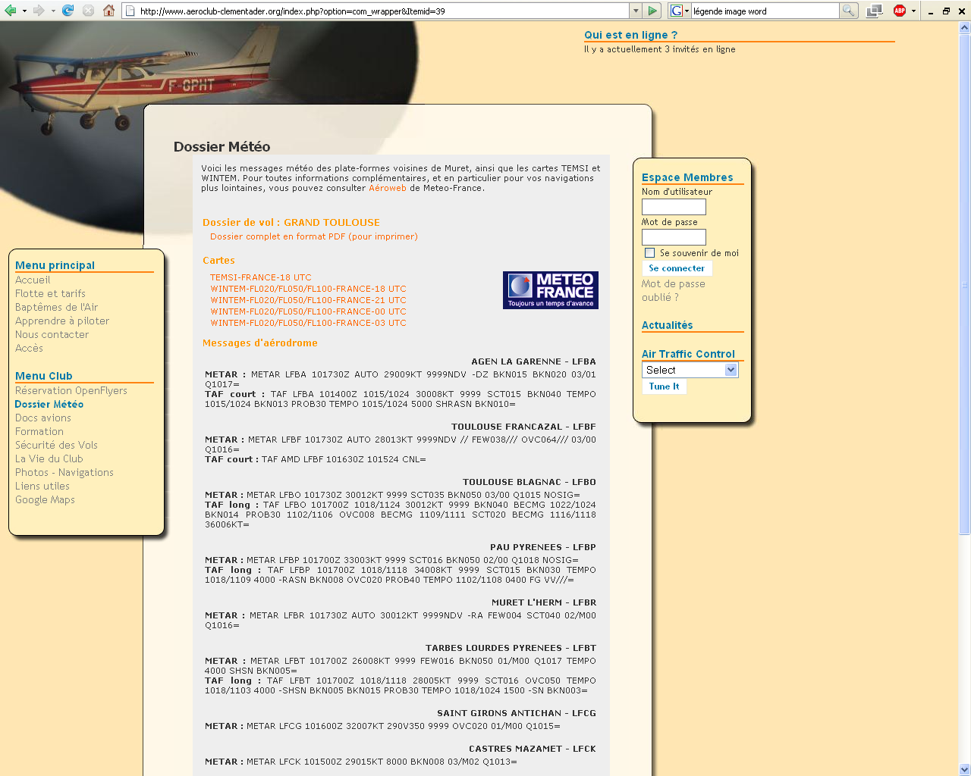
Sample of flight documentation on a flight school website
Notes:
Users can then merge the provided information into a flight documentation that contains nonmeteorological data and display the resulting document on their website or other media.

Slide 10
Certification and traceability requirements
Requirements:
  ICAO:
    Guidelines on the Use of the Public Internet for Aeronautical Applications (ICAO Doc 9855)
    Traceability requirements : 30 days archive of all flight documentation
  Single European Sky: certification requirements for MET service providers
  ISO 9001
  Internal audit of the entire system every year

Slide 11
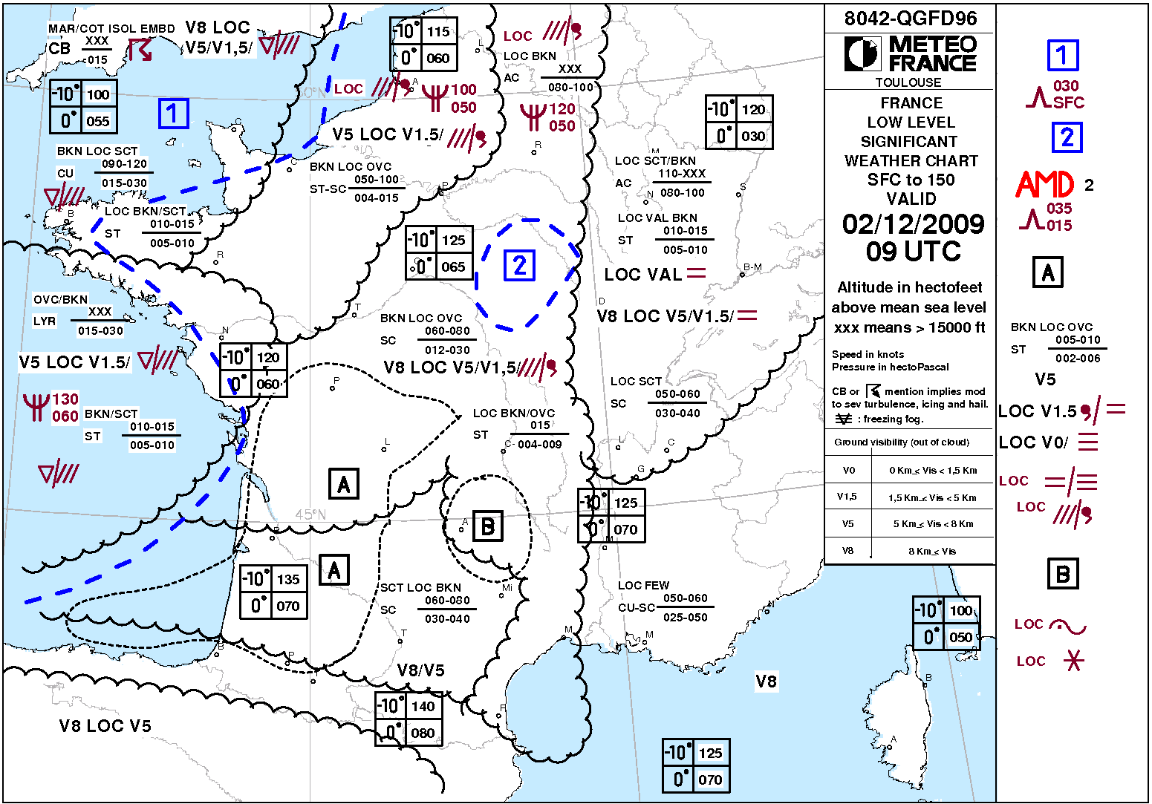
French SIGWX for LLF : TEMSI France BC
TEMSI France BC
(SIGWX for LLF) contents :
- forecast aeronautical weather
and
-significant events (SIGMET
contents)
below FL 150
updated 6 times a day (every 3 hours from 06 UTC to 21 UTC)
night updating in new organisation project
immediatly amended when necessary
easy to read
quick to decode and to localize all aeronautical events

Slide 12
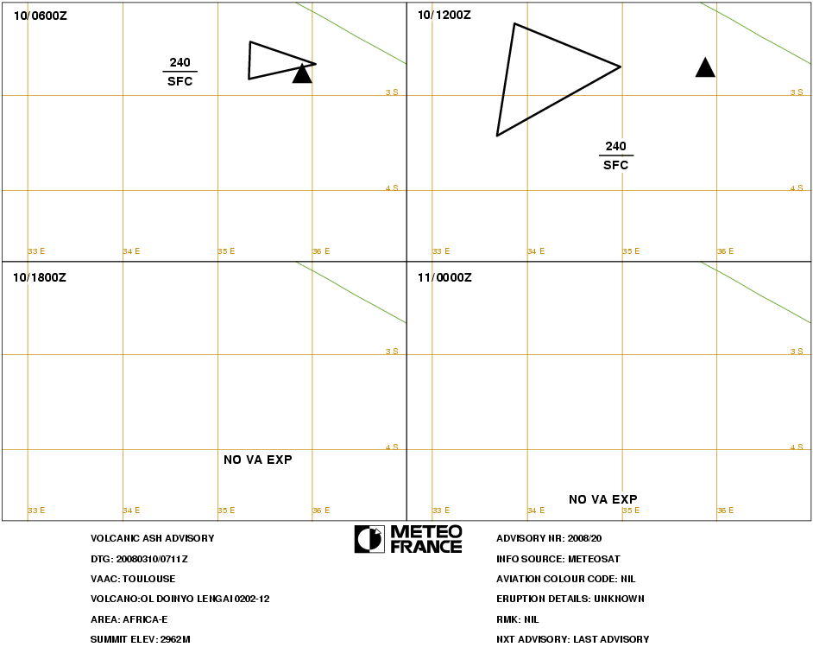
AIRMET and SIGWX LLF
SIGWX LLF is considered as a graphical GAMET
AIRMET becomes useless for LLF if TEMSI BC is amended when AIRMET limit for each event is exceeded (Annex 3 – appendix 6- (2.1.4))
Understanding a graphical product and localizing an event are easier and faster than text (aeronautical users confirmed) :
Example with VA Advisory :
FVXX02 LFPW 100722VA ADVISORYDTG:
20080310/0711ZVAAC: TOULOUSEVOLCANO
OL DOINYO LENGAI 0202-12PSN: S0246 E03555AREA:
AFRICA-ESUMMIT ELEV: 2962MADVISORY NR: 2008/20INFO
SOURCE: METEOSATAVIATION COLOUR CODE:
NILERUPTION DETAILS: UNKNOWNOBS VA DTG:
10/0600ZOBS VA CLD: SFC/FL240 S0240 E03600 –
S0225 E03520 - S0250 E03520 -S0240 E03600 MOV W
15 KTFCST VA CLD + 6H: 10/1200Z SFC/FL240 S0240 E03500
S0215 E03350 -S0325 E03340 - S0240 E03500FCST
VA CLD + 12H: 10/1800Z NO VA EXPFCST
VA CLD + 18H: 11/0000Z NO VA EXPRMK:
PLEASE CHECK SIGMET FOR CURRENT WARNINGS.
NXT ADVISORY: LAST ADVISORY=

Slide 13
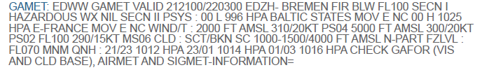
GAMET and AIRMET (1/2) : efficiency ?
Decoding and location events:
GAMET text (like AIRMET and SIGMET) takes a long time for decode
message and localize event on a navigation chart
One event AIRMET can concern several FIR, needing as many AIRMET as FIR concerned :
  ↓ Even more time to decode and localise event for users (during a LLF, the user must listen to the radio, write text to remember event location, locate the event on a chart, while continuing flying…)
  ↓ Even more workload for service providers (not efficient to reduce cost)
  ↓ And for several events concerning several FIR ?

Slide 14
GAMET and AIRMET (2/2) : some inconsistencies in Annex 3.
GAMET
Send to WAFC
➔
AIRMET
  Send to FIR
  ⬅
↓ AIRMET ( GAMET amendment ) are not transmitted to the same recipients

Slide 15
Conclusion : proposals
The following proposals could be considered:
↓ making use of graphical products for time critical data by Internet, while continuing to use the others ICAO dedicated distribution channels
↓ separating GAMET and AIRMET
↓ allowing SIGWX LLF to be used as graphical GAMET
↓ AIRMET could be replaced by SIGWX LLF (TEMSI BC) being continuously amended when AIRMET limit for each event is exceeded.

Slide 16
References
ICAO Annex 3 :
Chap 1: AIRMET definition
Chap 3.4.2 : Meteorological Watch Offices
Chap 6.5.2 and 6.5.3 : Forecats for LLF
Chap 7.1 and 7.2 : SIGMET and AIRMET
Chap 9.1.3.f : Services for operatorsand flight crew members : GAMET and AIRMET
Chap 11.5 : D-VOLMET service
Appendices and Attachements :
- Appendix 6 , chap 2.1 and 2.2 (…… AIRMET )
Doc ICAO
Manual of Air Traffic Services Data Link Applications (Doc 9694)
Guidelines on the Use of the Public Internet for Aeronautical
Applications (Doc 9855)

Slide 17
Thank you.

